Slide 1
#!/UNIX®@50
(A Personal History)
By Gilbert Detillieux, Dec. 2019 MUUG Meeting

Slide 2
About me…
Student at U of Manitoba from 1979 to 1983
First exposed to UNIX in 1979, worked on it starting in 1980
Worked in industry from 1983 to 1989, trying to focus on UNIX support
Co-founded TUUG ca. 1988 (MUUG in 1992)
Began current job as a SysAdmin in October 1989 (30 years ago)
Focused on UNIX primarily for 40 years
Personal bias reflected in this history

Slide 3
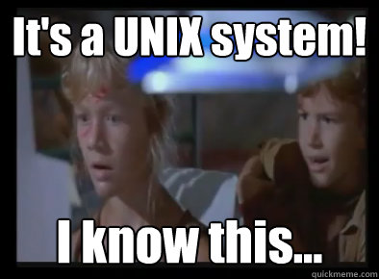
Source: http://www.quickmeme.com/meme/356f74

Slide 4
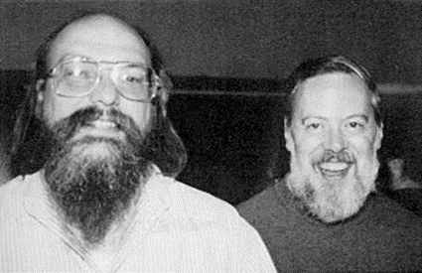
August 1969
Let’s start at the beginning… (or Epoch?)
Bell Lab pulls out of Multics project (with MIT and GE)
Ken Thompson works on new OS for little-used DEC PDP-7, assembler & editor
With Dennis Ritchie & others, implement hierarchical FS, device files, shell & utilities
Modelled on Multics features, but simplified
In 1970, Brian Kernighan coins the name Unics, later spelled as UNIX.
Source: https://en.wikipedia.org/wiki/History_of_Unix
https://www.youtube.com/watch?v=EY6q5dv_B-o

Slide 5
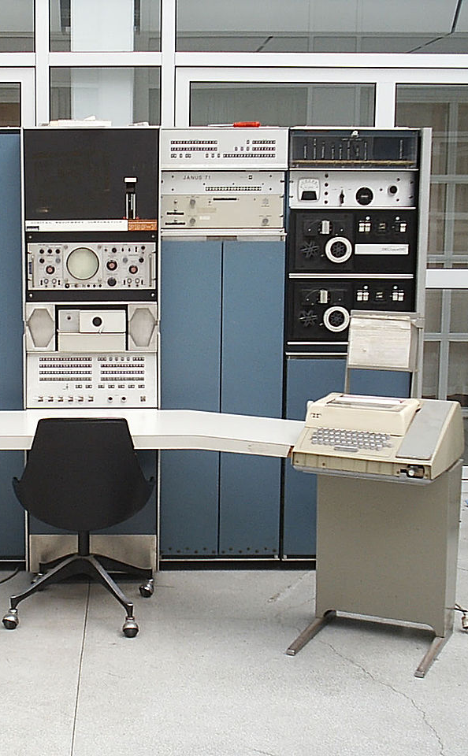
The PDP-7
Manufacturer | Digital Equipment Corporation
Type | Minicomputer
Release date | 1965; 54 years ago
Introductory price | US$72,000 (equivalent to $572,427 in 2018)
Units sold | 120^{[1][2]}
Units shipped | 120^{[2]}
Memory | 4K words (9.2 KB) (expandable up to 64K words (144 KB).)^{[1]} 8Kw (18.4KB) at Bell Labs
Storage | Paper-tape and dual transport DECtape drives (type 555) 1MB disk (RB09 same as an RD10)
Display | Printer
Input | Keyboard
Platform | DEC 18-bit
Sources: https://en.wikipedia.org/wiki/PDP-7 http://bsdimp.blogspot.com/2019/07/the-pdp-7-where-unix-began.html

Slide 6
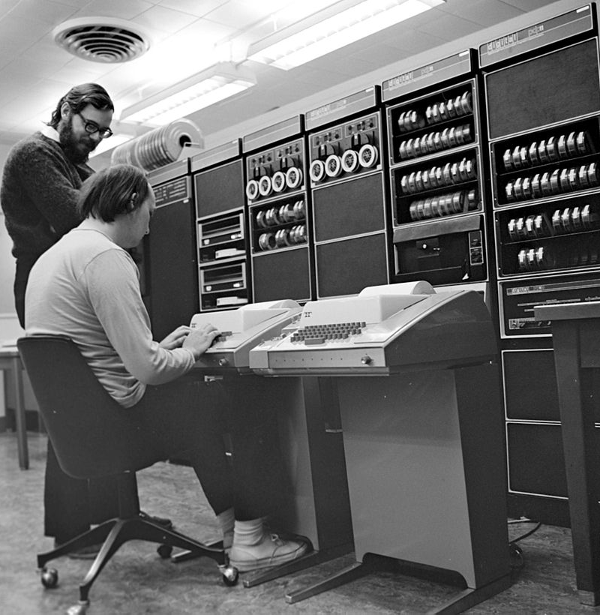
1970 to 1979
From Infancy to Portability…
OS rewrite for PDP-11 in 1970
Name officially becomes UNIX
Versions 1-4 written in assembler
K & R C compiler introduced in V2
V4 rewrite in C in 1973
V5 licensed to educational institutions in 1973
V6 first licensed to companies in 1975 @ US$20K!
V7 is first “portable” version, in 1978
First Bell Labs port is to Interdata 8/32
UNIX/32V for DEC VAX then released
Source: https://en.wikipedia.org/wiki/History_of_Unix

Slide 7
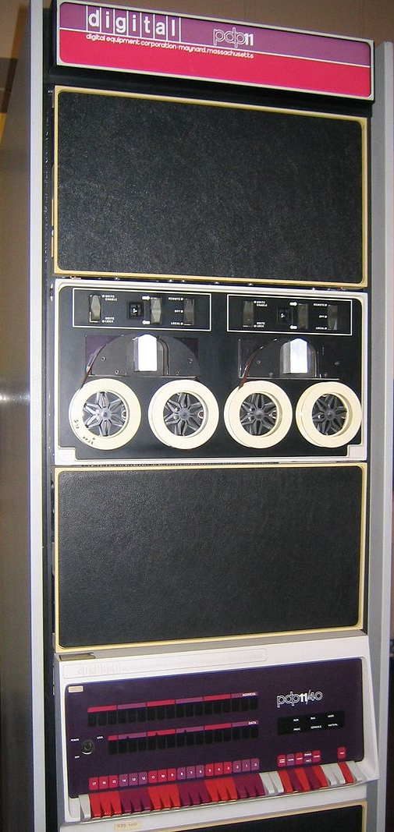
PDP-11
16-bit word length
Orthogonal instruction set & general-purpose registers
Memory-mapped I/O
Vectored interrupts, 4 priority levels
Unibus architecture
Q-bus for later LSI-11 & MicroPDP-11
Limitations led to development of VAX-11, 32-bit architecture
Source: https://en.wikipedia.org/wiki/PDP-11

Slide 8
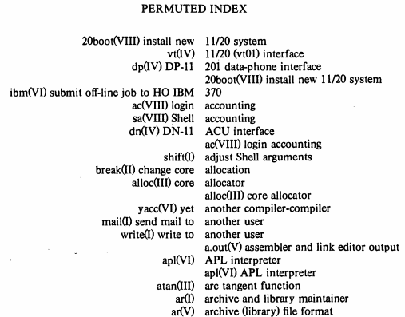
Source: https://www.tuhs.org/Archive/Distributions/Research/Dennis_v5/v5man.pdf

Slide 9
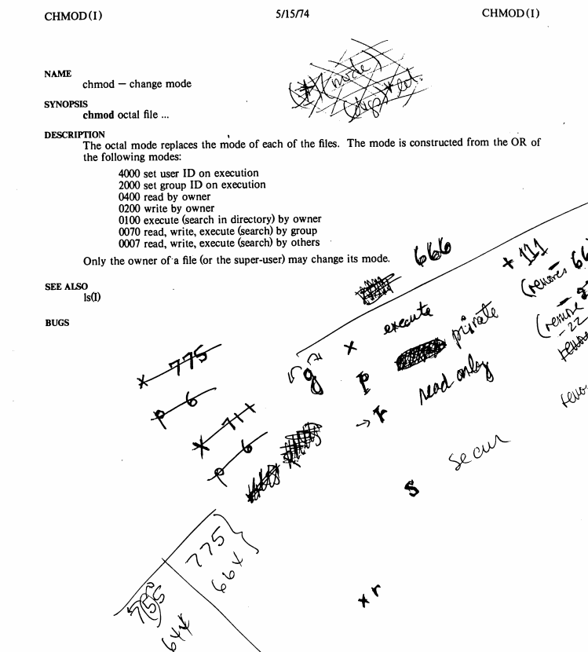
Source: https://www.tuhs.org/Archive/Distributions/Research/Dennis_v5/v5man.pdf

Slide 10
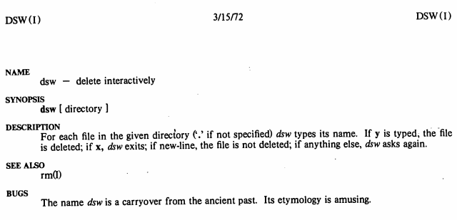
Source: https://www.tuhs.org/Archive/Distributions/Research/Dennis_v5/v5man.pdf

Slide 11
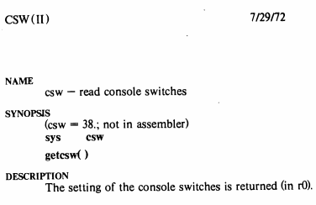
Source: https://www.tuhs.org/Archive/Distributions/Research/Dennis_v5/v5man.pdf

Slide 12
Man Pages by Version
Version | V1 | V5 | V6 | V7
Commands(1) | 61 | 81 | 81 | 136
System Calls(2) | 34 | 41 | 43 | 47
Subroutines/libc(3) | 14 | 36 | 39 | 56
Special Files(4) | 7 | 18 | 18 | 16
File Formats(5) | 9 | 13 | 16 | 17
User-maintained/games(6) | 10 | 30 | 25 | 16
Miscellaneous(7) | 18 | 5 | 4 | 6
System Maintenance(8) | -- | 23 | 27 | 7
Sources: https://www.tuhs.org/Archive/Distributions/Research/ https://9p.io/7thEdMan/

Slide 13
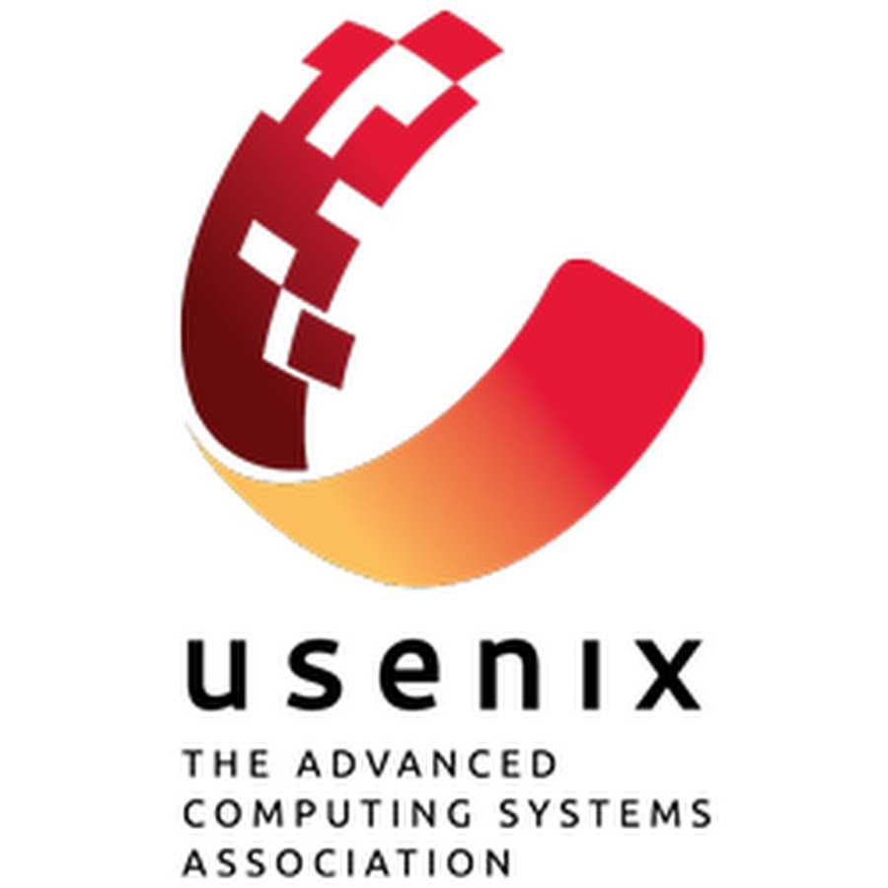
USENIX
The “UNIX Users Group”
Founded in 1975
Had to change name to avoid trademark infringement
Based out of Berkeley, CA
Publishes ;login: magazine
Sponsors several annual conferences
Fairly academic focus
Sources: https://en.wikipedia.org/wiki/USENIX
http://static.usenix.org/publications/login/whysemi.html

Slide 14
BSD
Berkeley Software Distribution
Initial release in 1978
Originally called Berkeley Unix
1BSD based on Bell Labs (Research) UNIX V6
An add-on, rather than a full OS on its own
Included a Pascal compiler, ex editor
30 copies licensed
2BSD released in May 1979
Added vi (visual editor) and the C Shell
75 copies licensed (including one to U of M)
3BSD released at end of 1979
Based on UNIX/32V, added full VM support for VAX
Sources: https://en.wikipedia.org/wiki/Berkeley_Software_Distribution
https://en.wikipedia.org/wiki/History_of_the_Berkeley_Software_Distribution

Slide 15
1980 to 1989
From Curiosity to Viability…
AT&T announced UNIX System III, based on V7 and PWB/UNIX, in 1981
1983 anti-trust case against AT&T leads to Bell Labs break-up, but allows unrestricted commercial licensing
SVR1 released later in 1983
Research UNIX V8, V9, V10, leading to Plan 9
Richard Stallman starts GNU Project in 1983
Andrew Tanenbaum releases MINIX in 1987
UNIX & variant (clone) ports to 16 arch, 60 vendors, including Xenix & PC/ix on 8086 (& Apple Lisa on 68000)
mainframe UNIX: Amdahl UTS in 1981, IBM IX/370 and VM/IX
Sources: https://en.wikipedia.org/wiki/History_of_Unix
https://en.wikipedia.org/wiki/MINIX

Slide 16
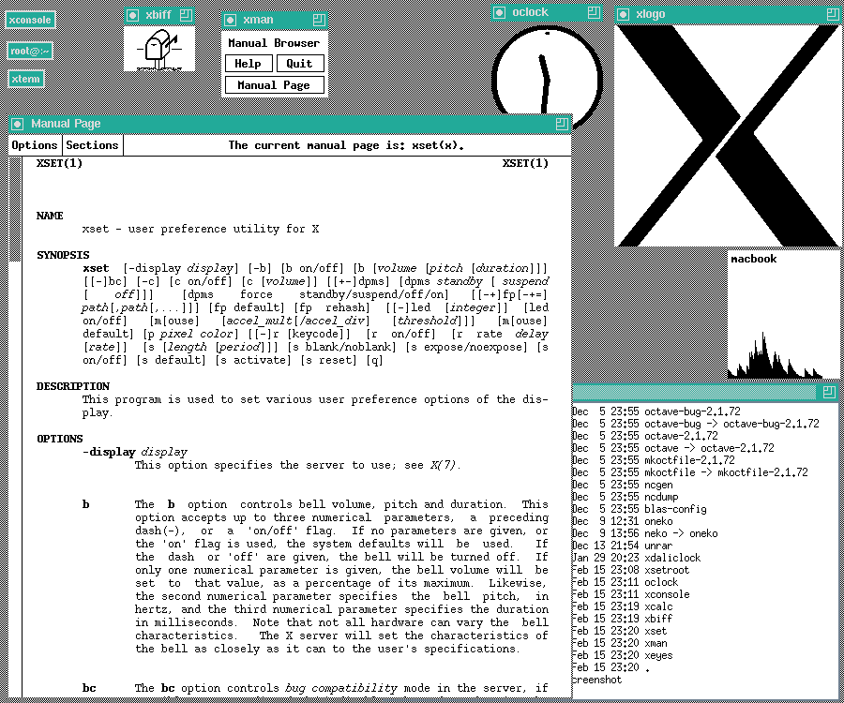
1980 to 1989
From Curiosity to Viability…
BSD developer Bill Joy co-founds Sun Microsystems in 1982, creates SunOS & Sun workstations
4BSD adds job control, fast file system, sockets & TCP/IP stack
X Window Release 1 in June 1984
X11R2 (X Consortium release) in Feb 1988
X11R4 adds XDMCP, twm, & more in Dec 1989
Sources: https://en.wikipedia.org/wiki/History_of_Unix https://en.wikipedia.org/wiki/X_Window_System

Slide 17
1980 to 1989
The UNIX Wars, Part 1:
AT&T SysV and BSD diverge, with incompatible system calls, libraries, file system standards
AT&T responds with SVID in 1985
X/Open (Euro vendor) consortium work toward open system spec (eventually SVID)
IEEE works with others on POSIX spec in 1988
AT&T in 1988 works with
SCO to merge SysV and Xenix into System V/386
Sun to merge SysV, BSD/SunOS and Xenix into SVR4
Source: https://en.wikipedia.org/wiki/History_of_Unix

Slide 18
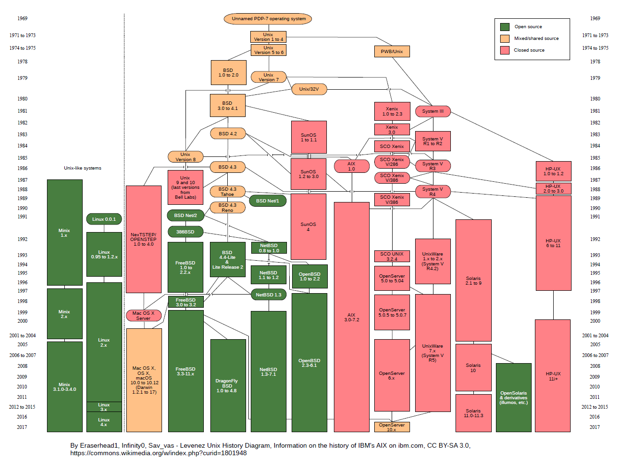

Slide 19
/usr/group
A.K.A. UniForum
Founded in 1980
Industry association dedicated to the "promotion of the UNIX operating system“
Independent from, but collaborated with USENIX
Changed name to UniForum in 1989
Worked with IEEE on POSIX standards
Faded into obscurity by the mid/late-2000’s
Sources: https://www.usenix.org/about/history/international
https://books.google.ca/books?id=-inF2Gv9w68C&pg=PT82

Slide 20

The Birth of MUUG
Technical UNIX™ User Group
/usr/group/winnipeg formed in 1985
Heavy focus on UNIX advocacy and marketing
Affiliated with /usr/group/canada
Crashed and burned in early 1986
Last 3 attendees at (final?) meeting work on alternative group
Conduct UNIX user survey, trying to meet user needs
TUUG begins very informal monthly meetings in fall 1986, with tech./education focus
Name notation, newsletter, formal membership by fall 1988
Source: https://muug.ca/about.html

Slide 21
1988: We Broke the Internet, pt.1
The Morris Internet Worm
Written by Robert T. Morris in 1988
Exploited UNIX vulnerabilities:
Debug mode in sendmail
Buffer overrun in fingerd
Weak security settings in rexec/rsh
First person indicted under Computer Fraud and Abuse Act (1986), in July 1989
Convicted in 1990
Clifford_Stoll writes “The Cuckoo’s Egg” in 1989, based on capture of Markus_Hess
Source: https://en.wikipedia.org/wiki/Robert_Tappan_Morris

Slide 22
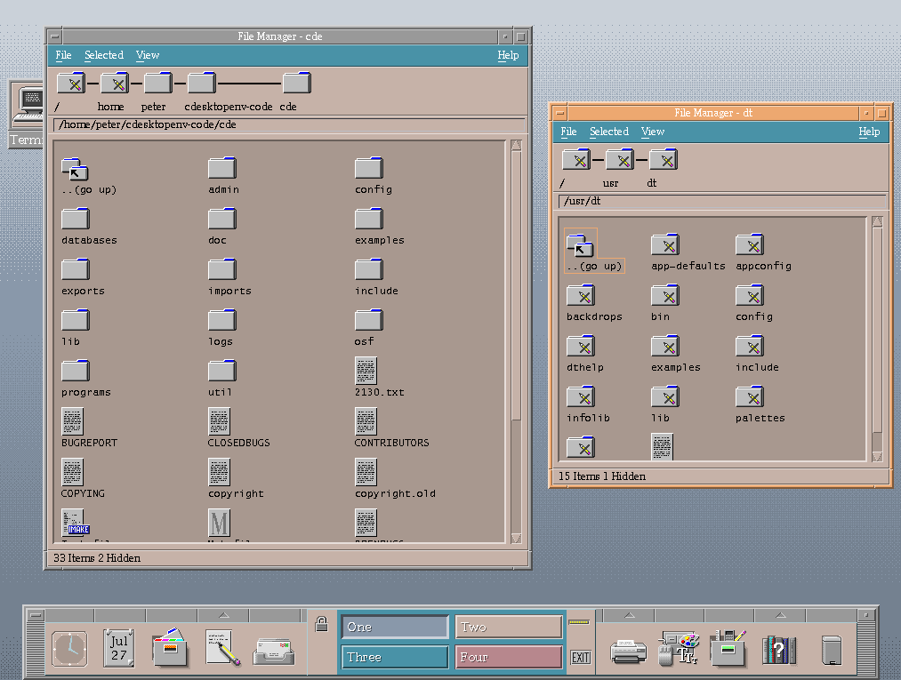
1990 to 1999
From Open Standards to Open Source…
Linus Torvalds releases Linux in 1991
AT&T and Sun form UNIX International, as competitor to X/Open’s OSF, part ways soon after
UI & OSF merge in 1994, abandon OSF/1
OSF/1 rebranded as Digital UNIX in 1995
Compaq buys out Digital in 1998, Tru64 UNIX rebranding
AT&T sells SVR4 rights to Novell
UnixWare merges NetWare with SVR4
UNIX trademark transferred to X/Open in 1993
X/Open merges with OSF into Open Group in 1996
Sources: https://en.wikipedia.org/wiki/History_of_Unix
https://en.wikipedia.org/wiki/Tru64_UNIX

Slide 23

The Evolution of MUUG
Manitoba UNIX® User Group
Group continues to grow as Internet becomes popular
Group’s executive meets to formalize by-laws (the “Shoal Lake Accord”), summer 1991
Adopt current structure with board and officers
Name changed to reflect broadening membership in May-June 1992
MUUG Online Network Access (MONA) start June 1992, website by September 1994
Membership soars to peak of over 200, settles to ~60
Sources: https://muug.ca/about.html
https://muug.ca/pub/muuglines/pdf/tuug9205.pdf
https://muug.ca/pub/muuglines/pdf/muug9206.pdf

Slide 24
1990’s: We Broke the Internet, pt.2
The Rise of the Commercial Web…
.COM bubble strains DNS infrastructure
Graphic-intensive web sites break HTTP/1.0
More buffer overrun exploits
Kevin Mitnick IP spoofing attack in 1994
Mitnick sentenced to 5 years in 1999 (4 already served)
ISC proposes use of DNSSEC in 1998
Source: https://en.wikipedia.org/wiki/List_of_security_hacking_incidents

Slide 25
2000 to 2009
From Elation to Consolidation…
SCO sells UNIX assets to Caldera, which renames to The SCO Group
SCO Group sues Novell, IBM, others in 2003
Court rules in Novell’s favour in 2007
Ruling overturned in 2009, Novell wins jury trial in 2010
Lawsuit against IBM dismissed in 2016
HP buys Compaq in 2002, winds down Tru64 by end of 2004
Sun releases OpenSolaris, including ZFS, in 2005
Sun buys MySQL in 2008, Oracle buys Sun in 2009
macOS, Solaris, HP-UX, AIX remain in market
Linux dominates in open source
Sources: https://en.wikipedia.org/wiki/History_of_Unix https://en.wikipedia.org/wiki/Sun_Microsystems

Slide 26
2000’s: We Broke the Internet, pt.3
Dan Kaminsky and the DNS Vulnerability
In 2008 Dan Kaminsky discovers serious DNS flaw
Foreseen by Dan Bernstein in 2003
Lack of port randomization can lead to DNS cache poisoning
Kaminsky holds press conference July 2008
Details to be revealed at BlackHat conference a month later
Leaked details force rushed release of patches
Source: https://www.schneier.com/blog/archives/2008/07/the_dns_vulnera.html

Slide 27
2010 to 2019
From Obscurity to Ubiquity…
US & EU approve Oracle purchase of Sun in 2010
Oracle drops OpenSolaris, releases Solaris 11
Also continues to support Oracle Linux
RIP Dennis Ritchie, Oct 12, 2011
Linux turns 20 in 2011 (UNIX is 42!)
Raspberry Pi released in 2012, for US$35
HP commits to supporting Linux as alternative to HP-UX and Windows in 2012
Windows Subsystem for Linux added to Win10 in 2016; OpenSSH client & server added in late 2017
Toyota adopts Automotive Grade Linux in 2018
IBM buys Red Hat in late 2018
Source: https://muug.ca/pub/muuglines/

Slide 28
2010’s: We Broke the Internet, pt.4
From Security to Vulnerability?
Heartbleed, POODLE & 6 other OpenSSL vulnerabilities, all in 2014
“OpenSSL is not developed by a responsible team.” – Theo de Raadt
Shellshock (GNU Bash) remote execution, also in 2014
FREAK SSL/TLS (Factoring RSA Export Keys) in 2015
GHOST (Glibc gethostbyname stack buffer overflow), in 2015
VENOM vulnerability in QEMU, Xen & KVM, in 2015
Row Hammer DRAM vulnerabilities in 2013-2015
NTP DDoS in 2013, MitM bogus data in 2015
Dirty Cow (Linux kernel) privilege escalation, in 2016
Meltdown & Spectre in 2017
WikiLeaks publishes CIA Vault 7 Hacking Tools, in 2017
Sources: https://muug.ca/pub/muuglines/ https://www.darkreading.com/vulnerabilities---threats/the-10-worst-vulnerabilities-of-the-last-10-years/d/d-id/1325425

Slide 29
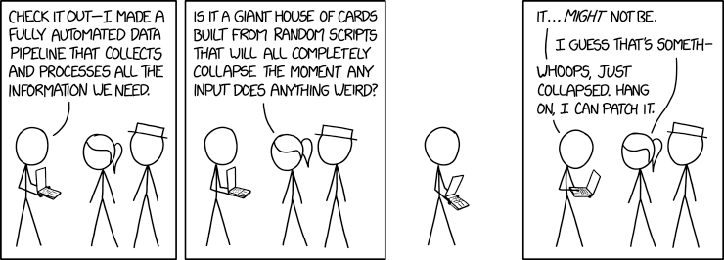
Data Pipeline
Source: https://xkcd.com/2054/

Slide 30
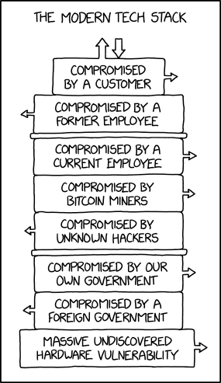
Stack
Source: https://xkcd.com/2166/

Slide 31
Five Decades of Hardware
Year | 1969 | 1979 | 1989 | 1999 | 2009 | 2019
Model | PDP-7 | PDP-11/45 | MicroVAX-11 | Sun Ultra 1/140 | Sun Fire X4200 | Dell PE R730xd
Bits/ word | 18 | 16 | 32 | 32 | 64 | 64
RAM | 4-64 Kw 9-144KB | 256KB ½ core | 13 MB 16 max | 224 MB | 12 GB | 64 GB
Storage | 1 x RB09/ RD10 1MB | 4 x RK05 2.5 MB/ea | 3 x CDC Wren VI 680MB/ea | SCSI 63 GB tot | IDE RAID5 5 TB tot | SAS RAID6 11 TB tot
OS | Unics (V0) | UNIX V6 | Ultrix-32 | Solaris 7 | CentOS 5 | Scientific Linux 6
Sources: https://en.wikipedia.org/wiki/PDP-7 and Gilbert’s own memory/notes

Slide 32
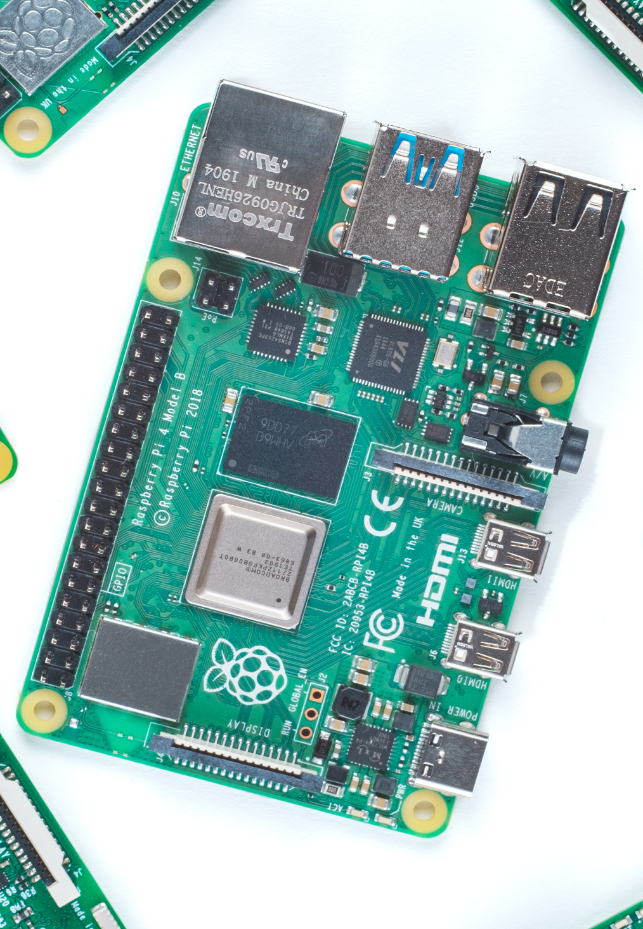
Raspberry Pi
Year | 2012 | 2017 | 2019
Model | B Rev 2 | Zero W | 4
Bits/ Cores | 32/ 1 | 32/ 1 | 64/ 4 v8
RAM | 256-512MB | 512MB | 1-4GB
Clock | 700 MHz | 1 GHz | 1.5 GHz
SD slot | SD, SDHC | microSD | microSD
Price | $35US | $10US | $35US (1GB RAM)
Source: http://socialcompare.com/en/comparison/raspberrypi-models-comparison

Slide 33
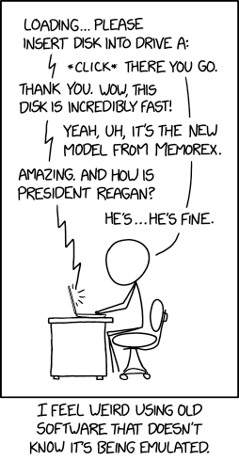
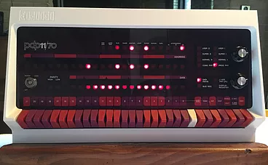
UNIX V7 on a PDP-11, on a Pi
Emulation: The Cure for Nostalgia
sudo apt-get install simh
wget https://www.tuhs.org/Archive/Distributions/Research/Keith_Bostic_v7/v7.tap.gz
gunzip v7.tap.gz
pdp11
(etc.)
Sources: https://obsolescence.wixsite.com/obsolescence/pidp-11, https://xkcd.com/2221/ https://www.linkedin.com/pulse/adventures-raspberry-pi3-1-running-unix-v7-emulated-pdp-11-chris-tham

Slide 34
2020 to 2038, and Beyond?
The UNIX Legacy
Portability and vendor independence
Open standards & accessible source code
Scalability (embedded to mainframe)
Hierarchical, mountable file systems
link/unlink (& symlink) concepts
device special files (hardware and virtual)
pipes, sockets, streams as files (generic I/O)
Small, modular commands
Programs as filters, with I/O redirection
Pipelines and shell scripts build complexity
Sources: https://www.bell-labs.com/usr/dmr/www/retro.pdf
https://www.cis.upenn.edu/~lee/07cis505/Papers/ritchie-bstj84.pdf

Slide 35
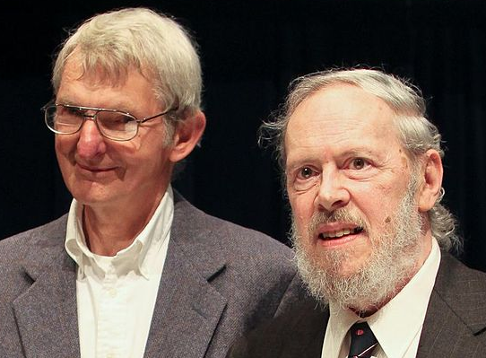
2020 to 2038, and Beyond?
The UNIX Philosophy:
Write programs that do one thing and do it well.
Write programs to work together.
Write programs to handle text streams, because that is a universal interface.
Doug McIlroy, as paraphrased by Peter H. Salus in A Quarter-Century of Unix (1994)
Source: https://en.wikipedia.org/wiki/Unix_philosophy

Slide 36
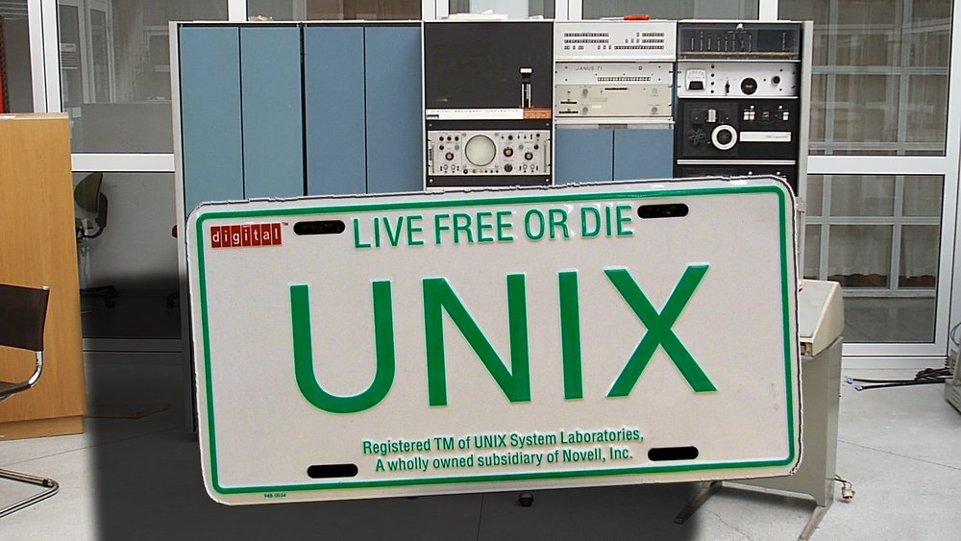
Source: https://www.digi.no/emne/unix

Slide 37

Except where otherwise noted, all content in this presentation is licensed under a Creative Commons “Attribution-ShareAlike 2.5 Canada” License.
http://creativecommons.org/licenses/by-sa/2.5/ca/deed.en_CA
UNIX is a registered trademark of The Open Group

